Slide 1
Balance/Control of a Ball (1D)
Pedro Rossa nº87344

Slide 2
Main Goals
Data Acquisition Systems
The aims of the project:
Detect the position of a ball/marbles buy the movemt of the support and move it to the middle;
Display the values on the Terminal;
Keep the ball center even when the support is moved by extrenal forces;
To achieve the goal of the project it will be use:
GY-521/MPU6050 – Gyroscope and Accelerometer;
Tower Pro Micro Servo (9g) – Servo to move the suport;

Slide 3
Components:
Data Acquisition Systems
Ardunio (UNO/MEGA);
Breadboard;
GY-521/MPU6050;
Tower Pro Micro Servo;

Slide 4
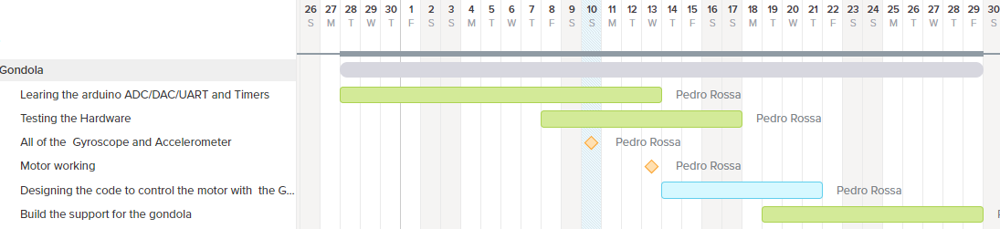
Plat of the Project
Data Acquisition Systems

Slide 5
Data Acquisition Systems
Build the support for the gondola
Testing the Hardware
Motor working
Designing the code to control the motor with the Gyro. data
Start
Gyroscope and Accelerometer
Assembling all the components.
Errors found
Testing for error.
Learning the Arduino
END

Slide 6
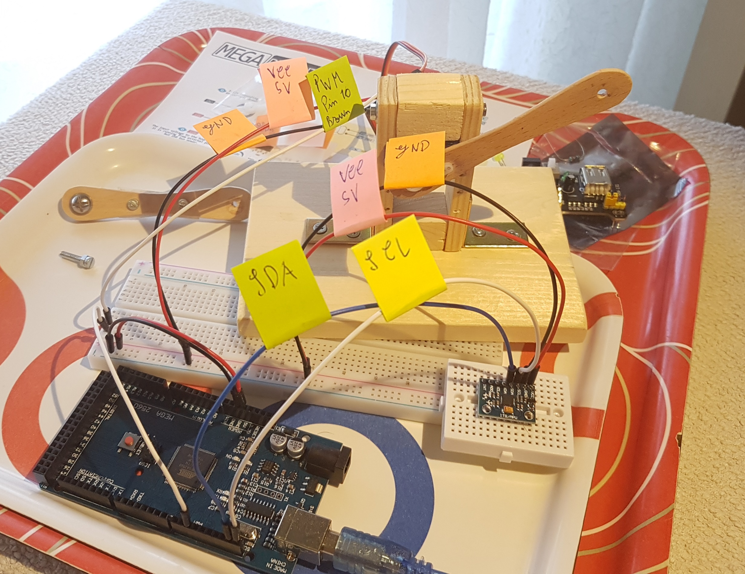
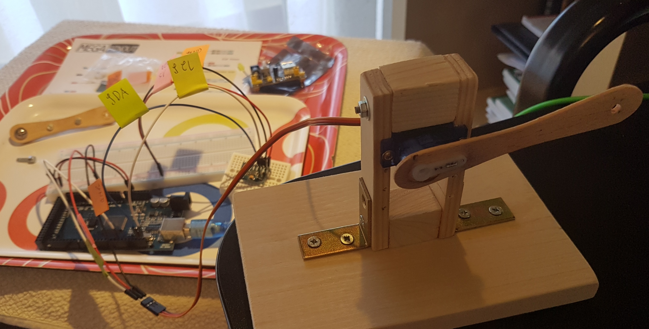
Update – 15/05

Slide 7
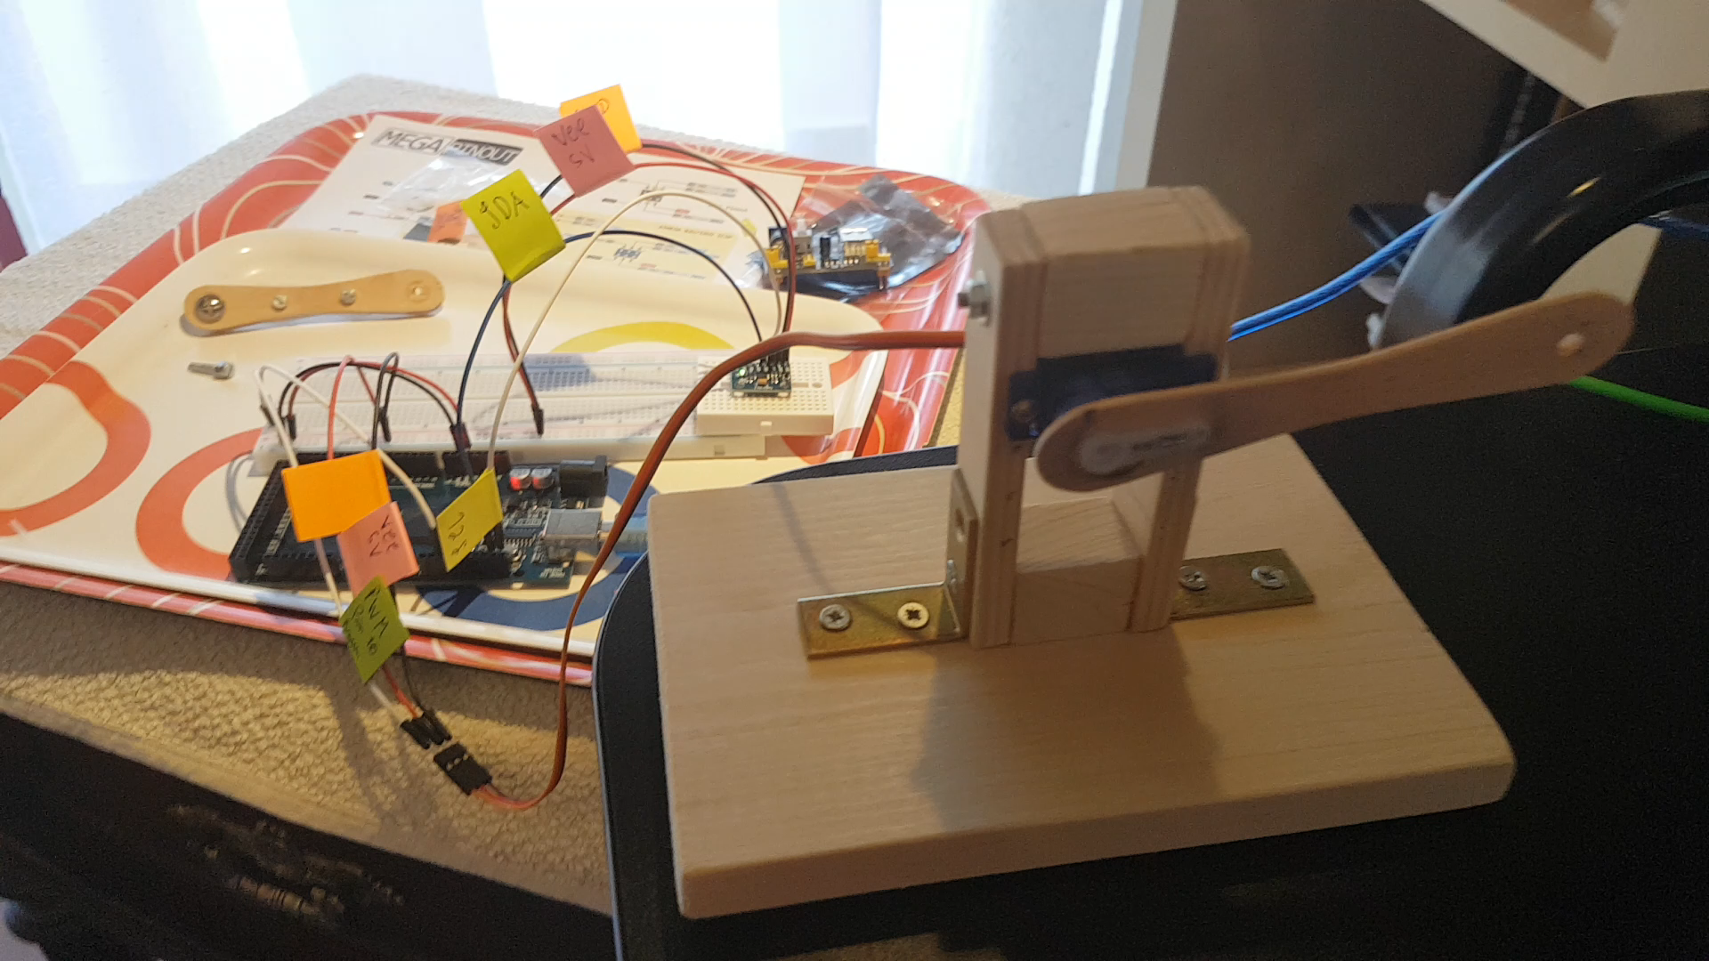
Update – 15/05
Things done:
Learned how to operate the servo and the GY-521/MPU6050 (with the lib. Wire and Servo);
Having a simple relation between the two sensors;
Must/all of the support done (this part had to be made sooner them planed because it will help more the final code);
TODO:
Learning how to do the some functioning that I have working with out using the lib. Wire and Servo;
Learning more about PID;

Slide 8
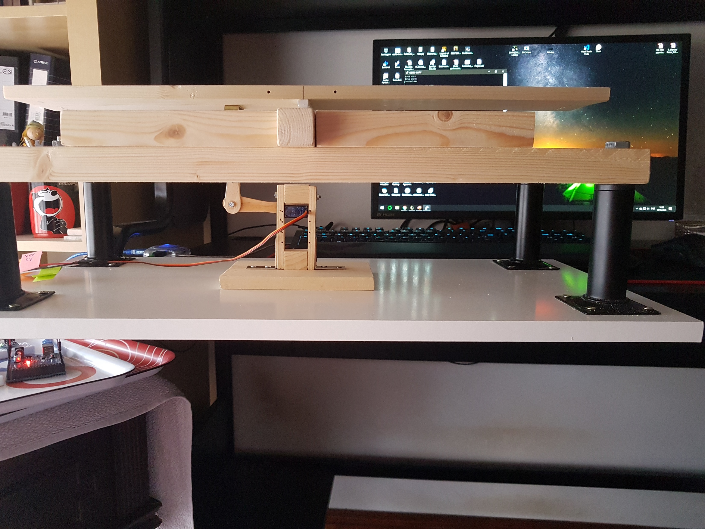
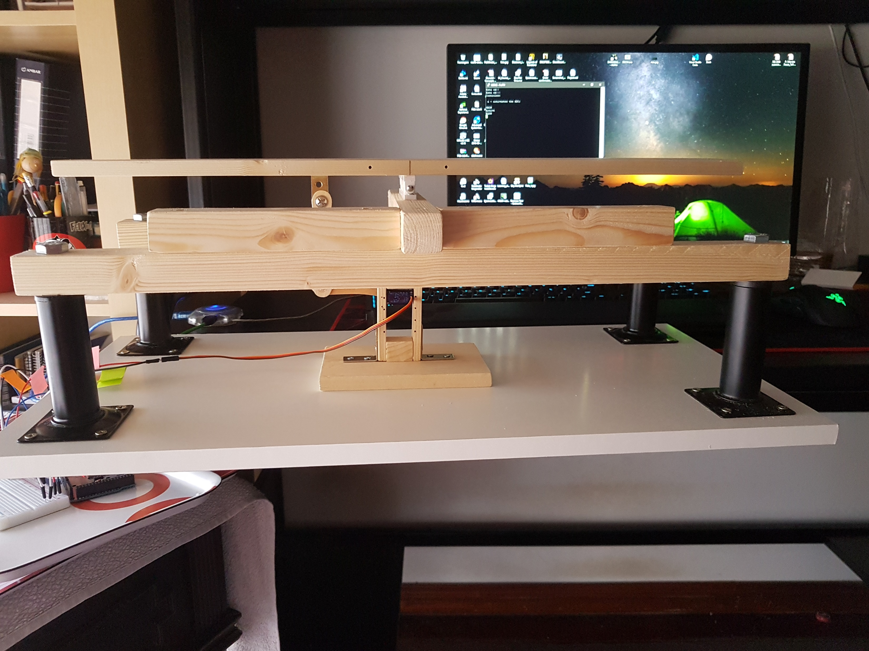
Update – 15/05
Ideas to add:
A encoder or potentiometer to calibrate manually the zero of the board;
A button that activates a calibration function of the gyroscope/accelerometer;

